Slide 1
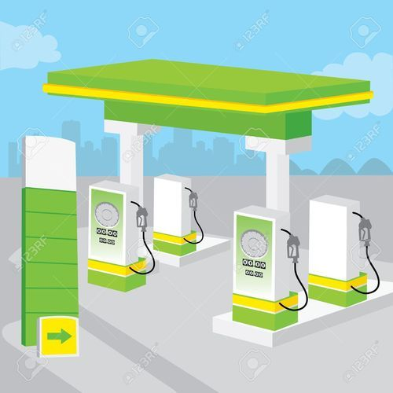

School of Computing Science & Engineering

Slide 2


Group-83
REVIEW-3

Slide 3
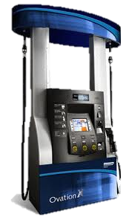



ABHISHEK THAPLIYAL-20BCE10231
PRESENTERS
GAURAV SAHU-20BCE11043
ANIKET KHARE-20BCE10363
SNEHA AGARWAL-20BCE10635
UTKARSH KUMAR-20BCE10622

Slide 4









Introduction/Problem Statement/Objectives
Architecture & Flow Diagram
Literature Review & Proposed System
Algorithm/Source Code/Demo Video
PPMS
.
Implementation Screenshots & Testing
Novelty & Real Time Usage
System Requirement
Result & Conclusion
Module Split-up
&
Gantt Chart

Slide 5

INTRODUCTION
The idea of our Petrol pump management system is mainly to manage daily records of petrol pump.
Using this system the admin will be able to check the employee attendance, quantity of petrol and diesel sold in any day, week or month.
We can also set the rating for petrol and diesel for that day as we know that it varies from day to day.
User can generate reports easily form this petrol pump management system.

Slide 6


LITERATURE REVIEW
Most of details are maintained manually at pertrol pump. Due to this the data retrieved is time consuming. Due to human calculation errors occur. Even when the data is maintained on spreadsheet inconsistency occurs as an order might be missed or wrongly entered or twice. So, we tried to make a software which can resolve this type of problem.
By making changes into following projects, we were able to create a proper environment to run our code and make our project successful. Following are the links for reference:
https://code---projects.org/petrol-pump-management-in---c-with-source-code/ (project idea)
https://sites.google.com//site/ignoubcafinalyearprojects//project/petrol-pump-management-system-project-report (implementation idea)

Slide 7
EXISTING SYSTEM
In present system all report work is done manually at the petrol pump. Admin user have to check each petrol pump machine the calculate the sold petrol, but in our proposed system user can check sold petrol from his monitor by clicking on some report button. Admin can also check which employee sold how much petrol and what amount he submitted to accountant at the end of the day. Admin can also check how much oil they sold in one day or one month. Admin can generate monthly sale report or annually sale report when they want. This system also help admin to generate the salary of each employee on the basis of his position and working hour.

Slide 8


LIMITATIONS OF EXISTING SYSTEM
Most of details are maintained manually. Due to this the data retrieved is time consuming. Due to human calculation errors occur.
Even when the data is maintained on spreadsheet inconsistency occurs as an order might be missed or wrongly entered or twice.
Data are stride an excel sheet which takes lot of time and data may be corrupted.
As storage and exchange of data is achieved only by use of excel sheets which lack validation
capabilities, there is always risk of invalid, inaccurate or incomplete data being fed in computer.
Difficulty in managing multiple forms.
Lack of security.

Slide 9
PROBLEM STATEMENT
The traditional methods of managing a Petrol Pump is not a easy job. It is very time consuming, requires to keep records manually and there can be human calculation errors. So, in order to get rid of these challenges a Petrol Pump Management System can be a very useful tool.

Slide 10





OBJECTIVES
To make a software which is easy to use.
To improve the present Petrol Pump Management System.
To check the quantity of fuel.
To minimize manual calculation.
Getting information related to sales on daily basis.

Slide 11
PROPOSED PETROL PUMP MANAGEMENT SYSTEM
As the work at petrol pump is done manually so it becomes hard for the supervisor to maintain a daily record. So we have developed this system to computerize all the reporting work of petrol pump.
From report module admin can also generate several reports like pumps daily earning report , employee shift delivery report , pumps report , cumulative daily report , salary report, amount of fuel sold . Admin can update many information in the system that’s why his account is protected with user name and password. Only authentic user can login to admin account.

Slide 12





ADVANTAGE OF OUR PROPOSED SYSTEM
A database application can be stored in computer effectively.
No cheating in the numbers can be done.
Whenever rates will fluctuate on time changes would be made.
Time management.
No need to check manually the quantity left
With this system, less man force will be required.

Slide 13




NOVELTY OF THE PROJECT
All the information about sale, purchase, stock will be maintain properly in this system.
All manual calculation of sale or all the money management will be performed by the computer automatically.
This system will provide timely report information.
It will produce report for sale, bill and stock information.
The computer can hold amount of data in its storage device

Slide 14
REAL TIME USAGE
As we know usually The management of the petrol pump is done by the manager manually, so here we are developing a software that is a Petrol pump management system .
This software is stand alone application useful for petrol pumps management system.This will be useful for viewing the information of all the pump available in the petrol pump .
So overall our idea is to develop a software that help us from switching from manual work to database .So that less man force is required and glitches can be minimized.

Slide 15



SYSTEM REQUIREMENT
Software Specification:-
Software requirements for this system
are as listed follows:--
basically we will be using cpp
language to develop this code as
it will be user friendly and
technically it will easier to excess
and operate. And the platform used
is Turbo C++.

Slide 16
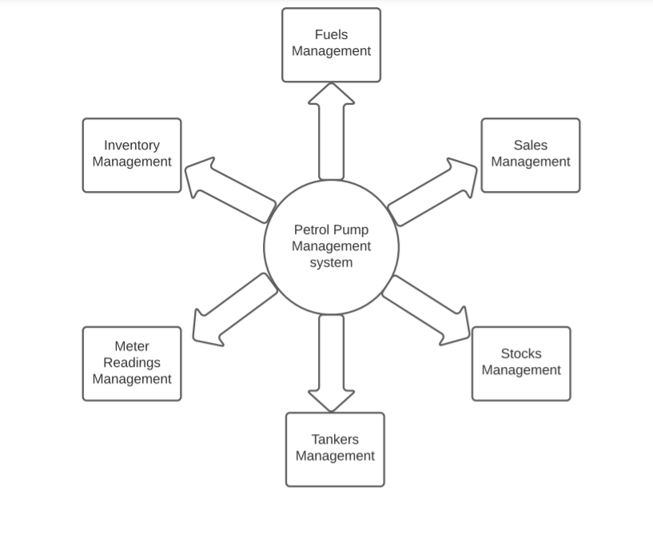
ARCHITECTURE DIAGRAM

Slide 17
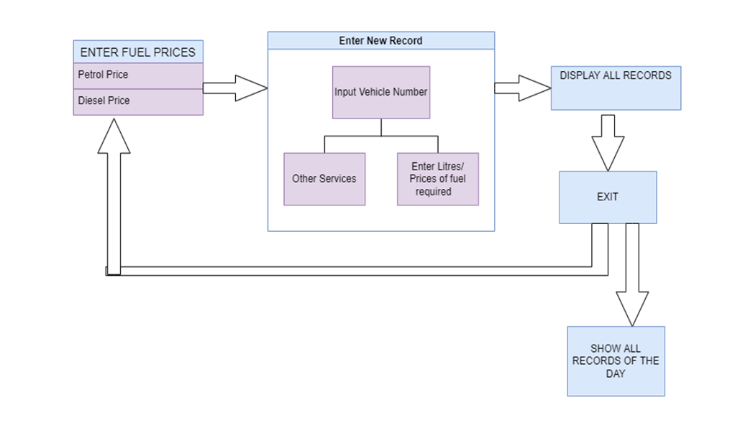
FLOW DIAGRAM

Slide 18
CODE STRUCTURE/ALGORITHM
Firstly we include all the necessary libraries that we are going to required in project which like:-
<ctype.h>, <string.h>, <stdio.h>, <dos.h>, <iomanip.h>, <iostream.h>, <fstream.h>, <process.h>, <conio.h>, etc.
After we will construct a parent class namely Pump() in which we will define some public, private and protected variables, data structures(arrays,vectors,etc)and functions that we are going to use in program.
Some important functions that we are going to use:-
1) void end() : It will show the ending page of the program when we choose to exit from program.
2) void sale(): It will show the page which will show the total sales of that day when we exit from the program
before the ending page.
3) void start(): It will show the starting page of our program after we run and compile the code. It is the
template of program introduction.
Cont…

Slide 19
4) int service(): It will show the options that customers wanted to opt in servicing of car like Washing ,
polishing, etc.
5) void entry(): It will show the main menu of program in which we can select what we wanted to do for
our like petrol, diesel, tyre, services, etc.
6) int tyers(): It will show options that what we wanted to do in tyre section of main menu like buying
tyres and tubes of vehicle.
7) void show(): It will show all the records of all the vehicles visited from the starting date of pump.
9) void find(): It is used to find the record of a particular vehicle by the vehicle number.
10) void password(): In the start of program it will ask for password of the program.
After the construction of these function finally we will construct the int main() function of code by combining the these function with appropriate direction of way and hence completes our code.

Slide 20
SOURCE CODE

Slide 21
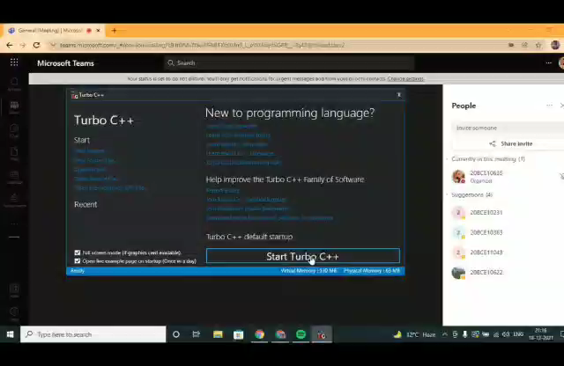
DEMO VIDEO

Slide 22

IMPLEMENTATION SCREENSHOTS
&
TESTING

Slide 23
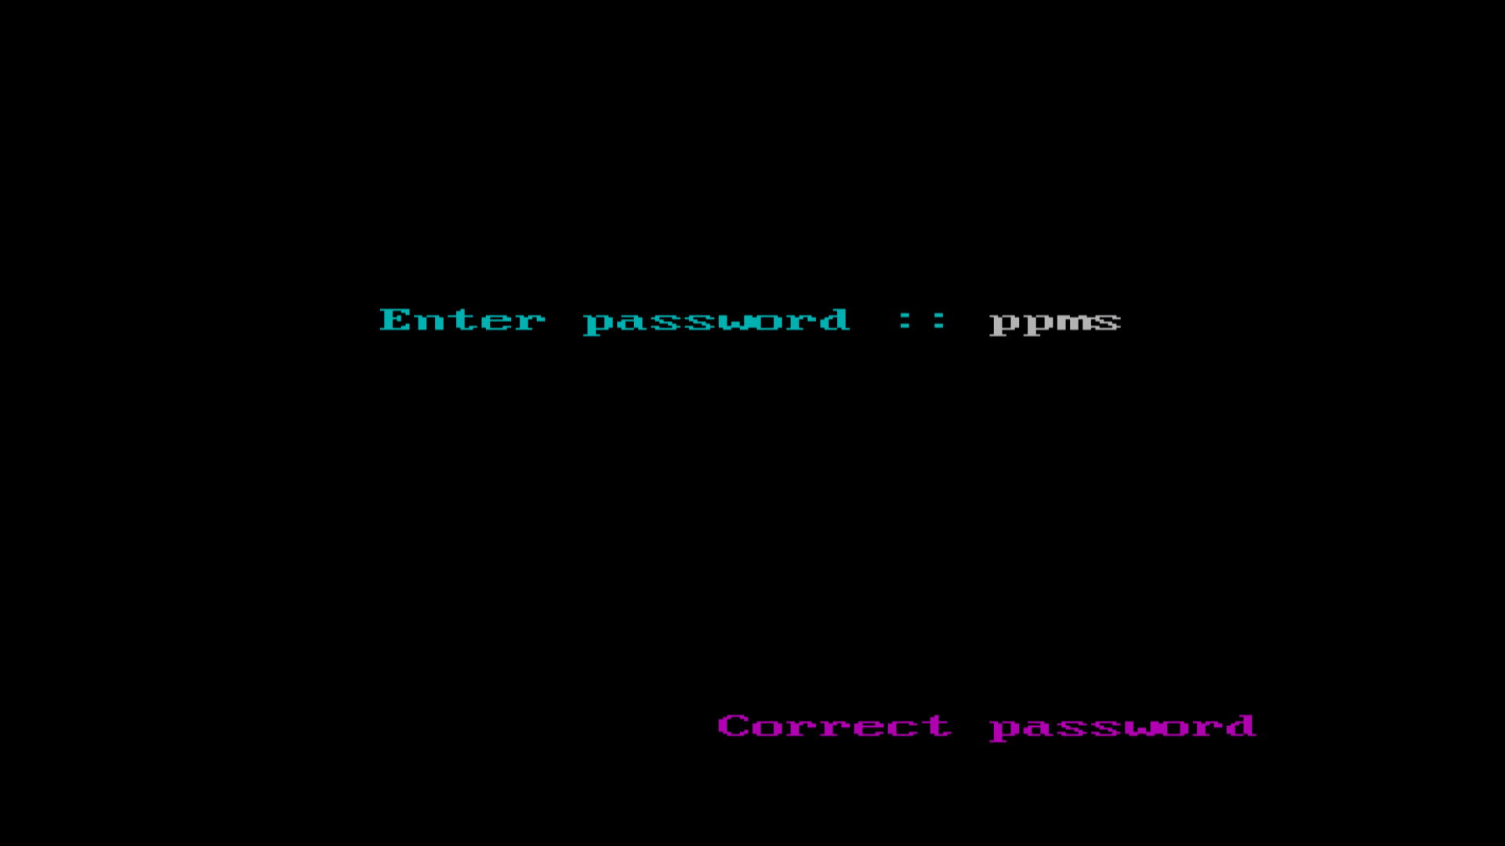

Slide 24
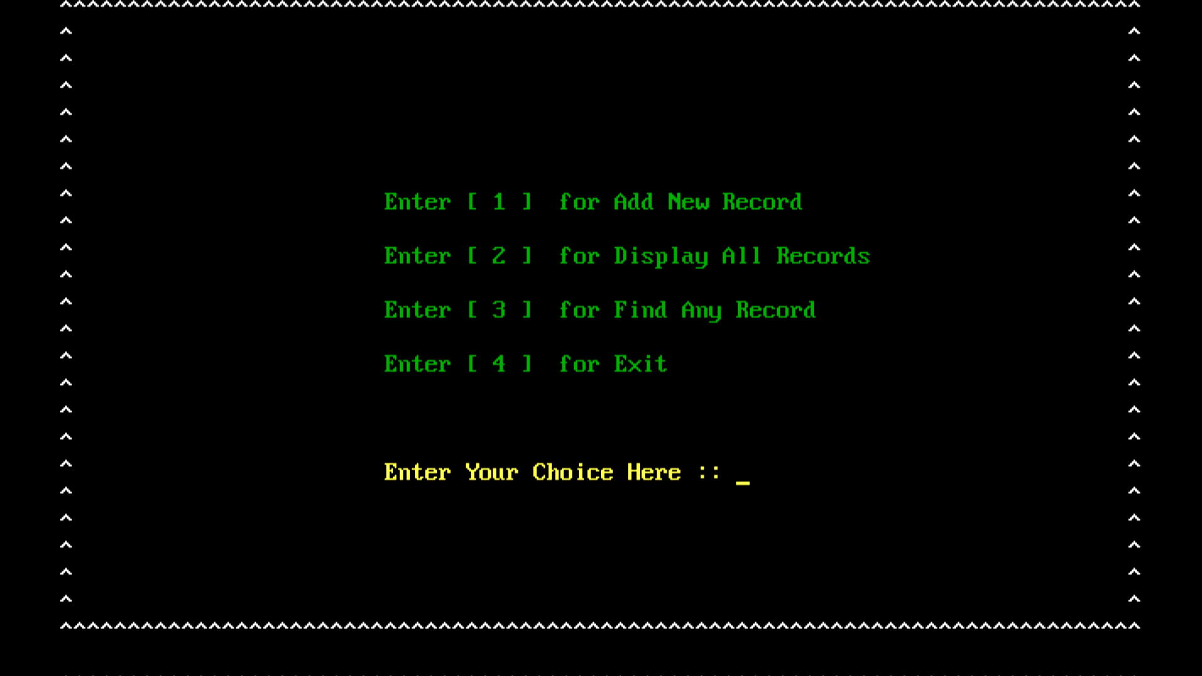

Slide 25
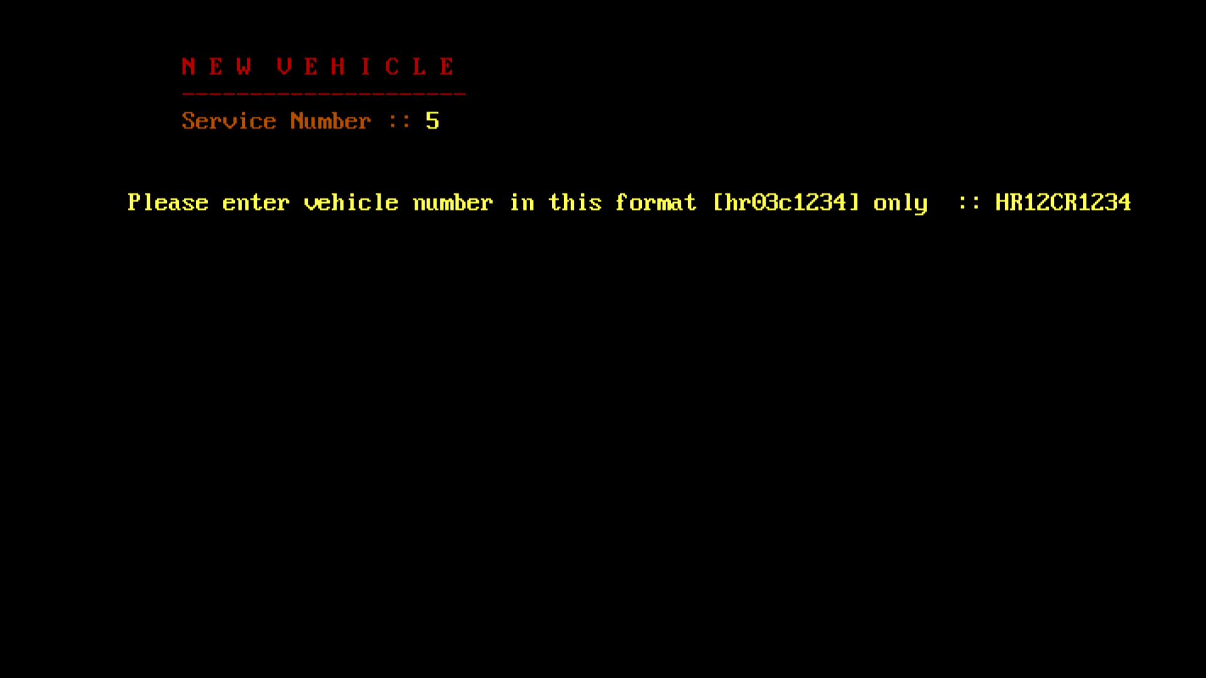

Slide 26
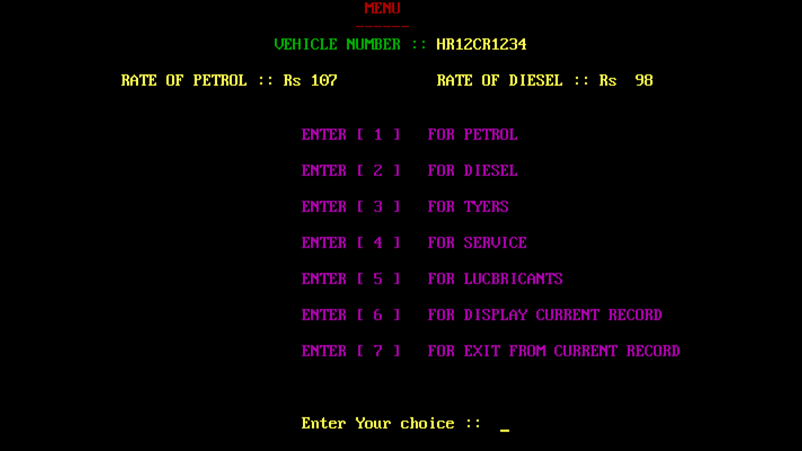

Slide 27
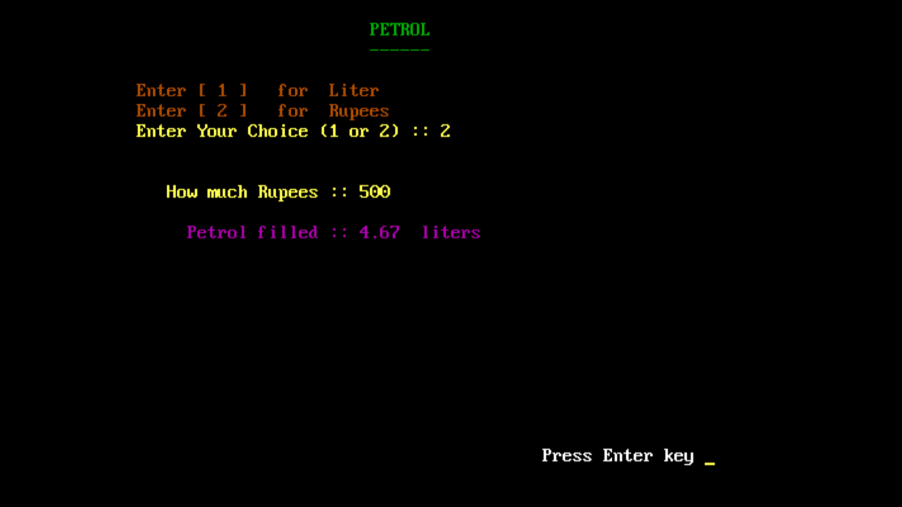

Slide 28
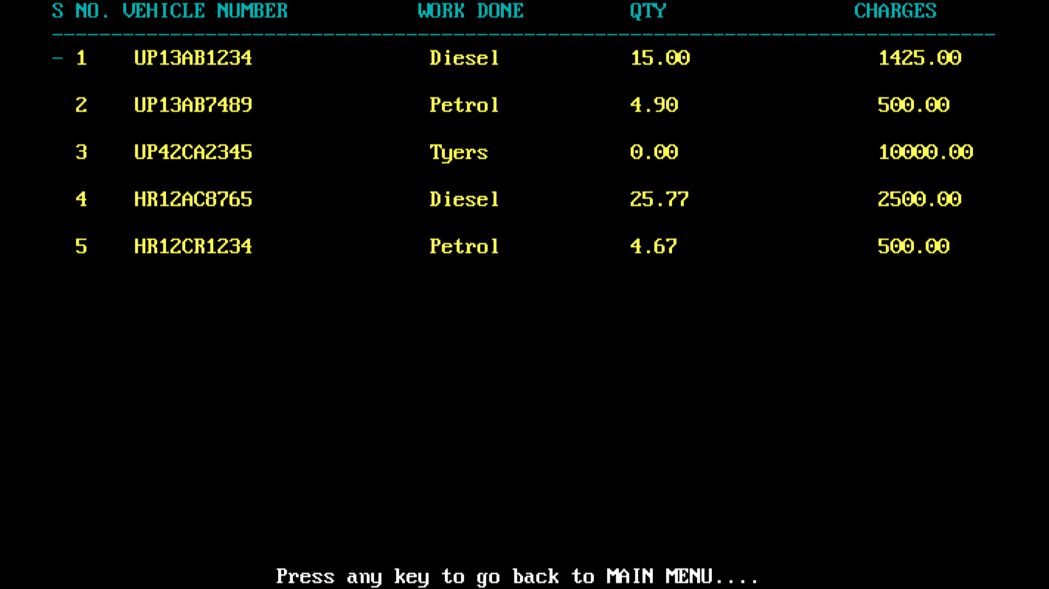

Slide 29
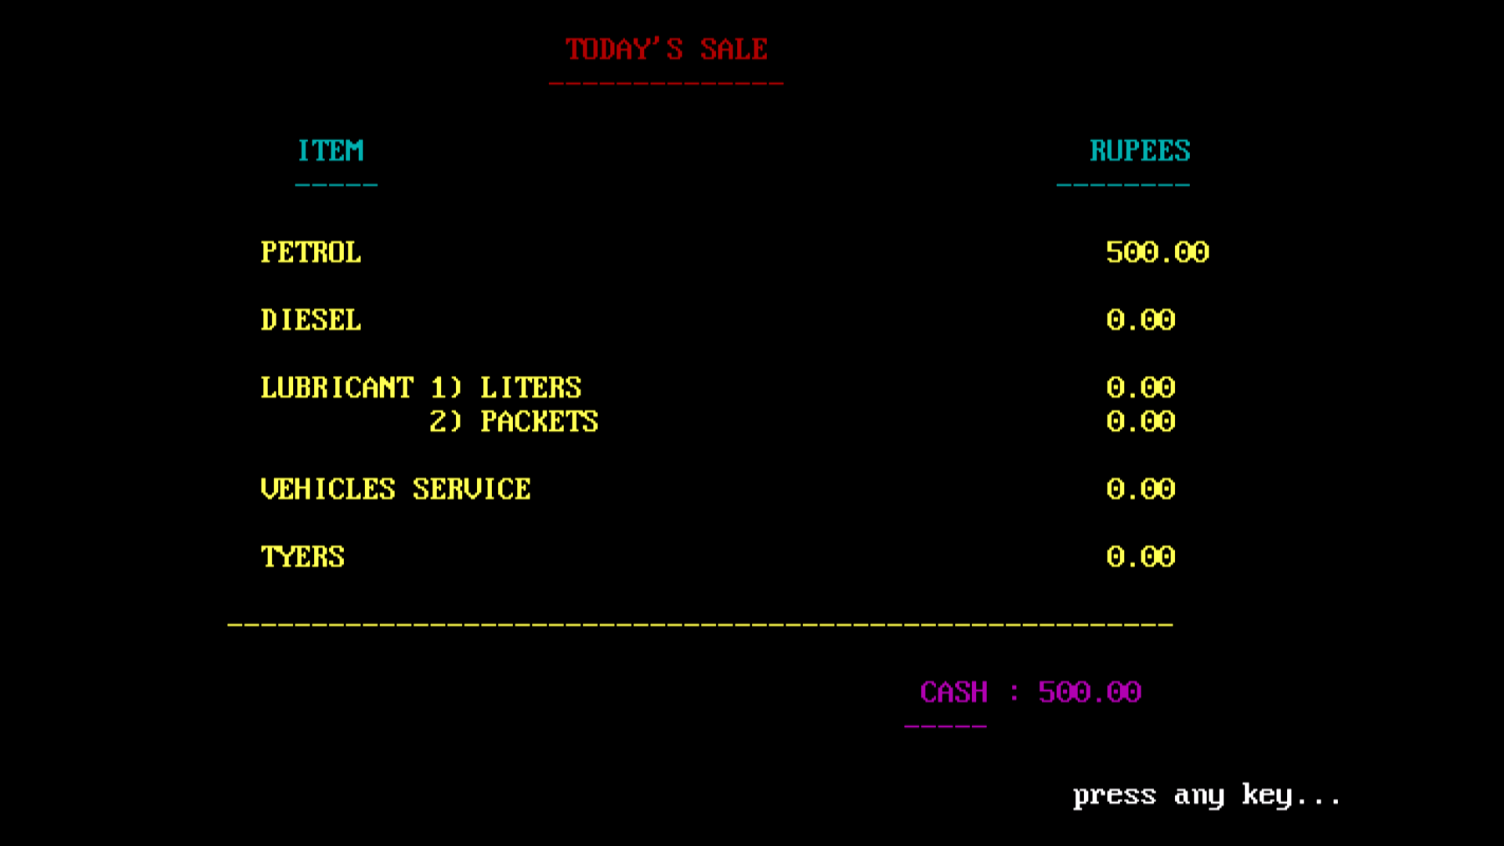

Slide 30
RESULT(I/O)
Business owner should be able to view fuel level and fuel sales.
Show the history of sales to the owner and the top management of the company.
Get Assistance on Fuel Price Risk Management.
Provide accurate sale report.

Slide 31
CONCLUSION
This is a stand alone software that will make it very easier to manage the petrol pump and keep record of day to day activities of a petrol pump securely.

Slide 32
MODULE SPLIT-UP
S.NO | Particular | Duration | Explanation
1. | Module-1 (Introduction) | 4 days | Introduction to Petrol Pump Management System, Its Objectives, Its Real Time Usage
2. | Module-2 | 4 days | Existing Petrol Pump Management System & Its Limitations
3. | Module-3 | 4 days | Proposed Petrol Pump Management System, Novelty, Its Advantage
4. | Module-4 | 6 days | Gantt Chart, Flow Diagram, Demo Code/Code Structure
5. | Module-5 | 7 days | Implementation Screenshots and Code/ Result and Conclusion

Slide 33
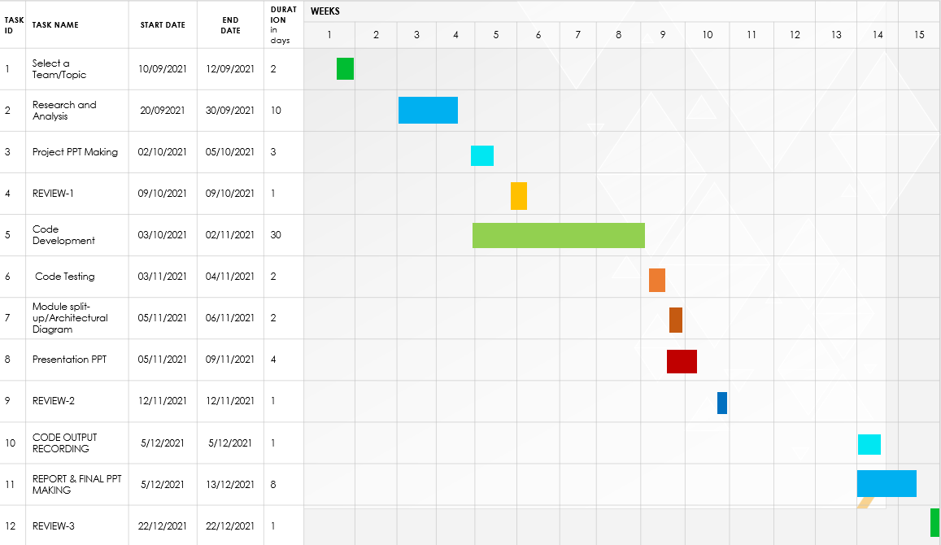
GANTT CHART

Slide 34

THANK YOU

